Slide 1
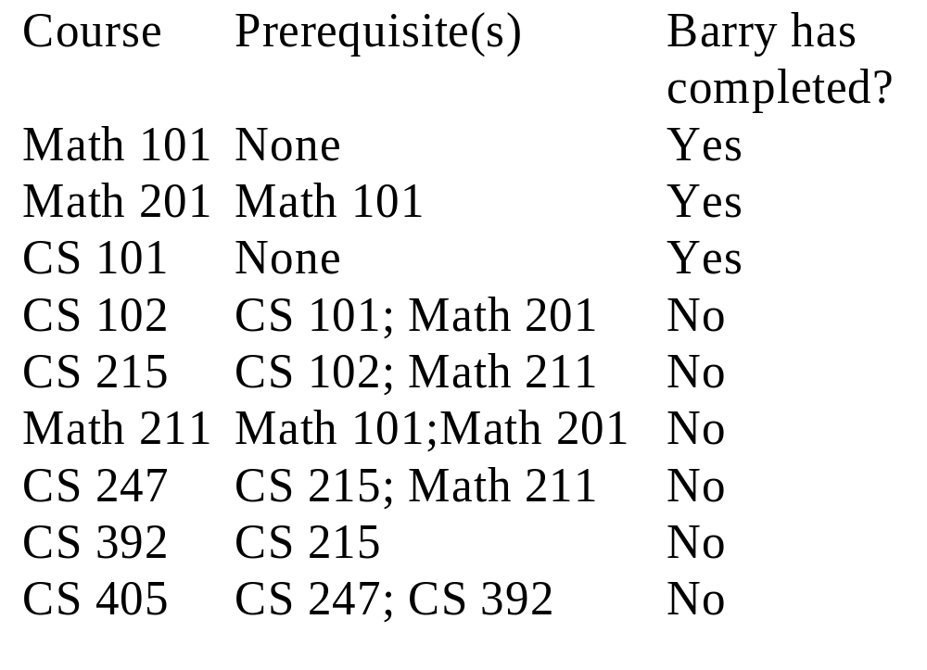
Table 12-1
26年 11月 8日
Copyright © 1997 Oxford University Press
All Rights Reserved

Slide 2
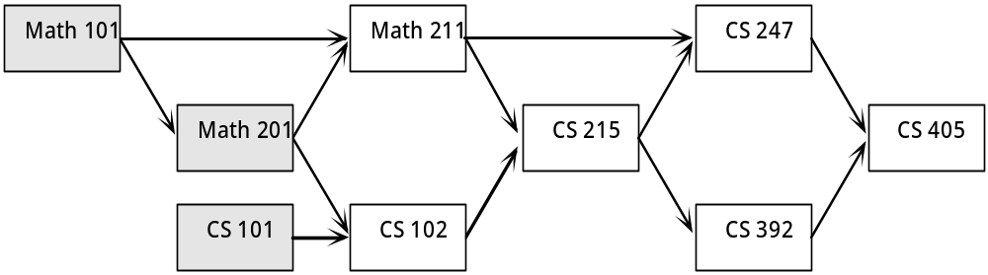
Figure 12-1: Course Prerequisites in Graphical Form
26年 11月 8日
Copyright © 1997 Oxford University Press
All Rights Reserved

Slide 3
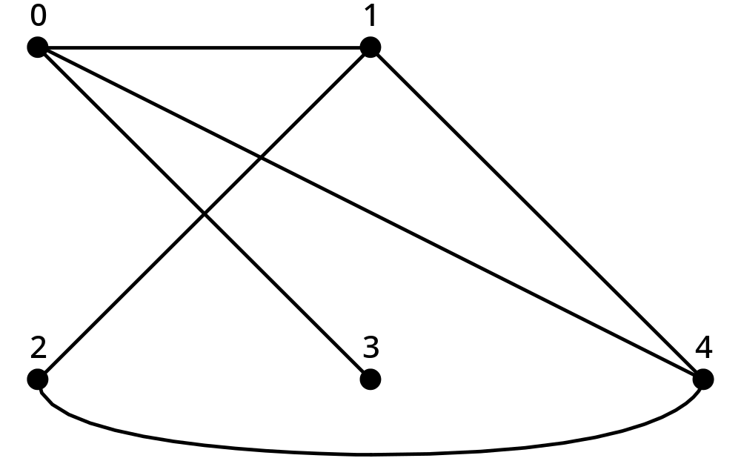
Figure 12-2: An Example Graph
26年 11月 8日
Copyright © 1997 Oxford University Press
All Rights Reserved

Slide 4
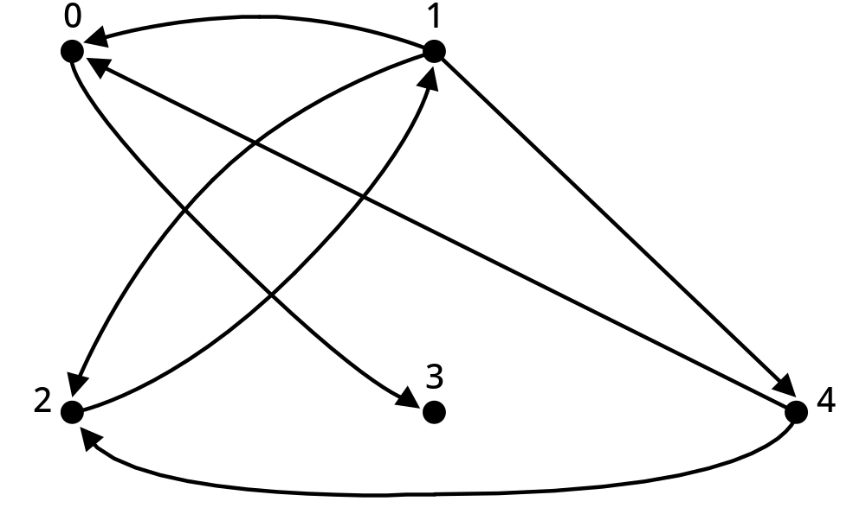
Figure 12-3: An Example Digraph
26年 11月 8日
Copyright © 1997 Oxford University Press
All Rights Reserved

Slide 5
Basic concets
G= (V,E)
V={0,1,2,3,4}
E={{0,1},{0,3},{0,4},{1,2},{1,4},{2,4}}
n=|V|, m=|E|
E={(0,3),(1,0),(1,2),(1,4),(2,1),(4,0),(4,2)}
26年 11月 8日
Copyright © 1997 Oxford University Press
All Rights Reserved

Slide 6
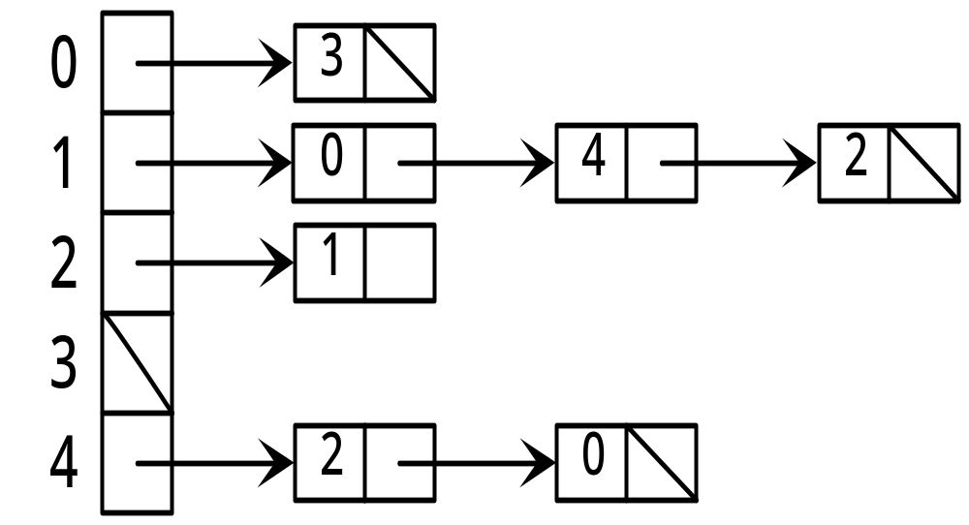
Figure 12-4: An Adjacency List of Figure 12-3
26年 11月 8日
Copyright © 1997 Oxford University Press
All Rights Reserved

Slide 7
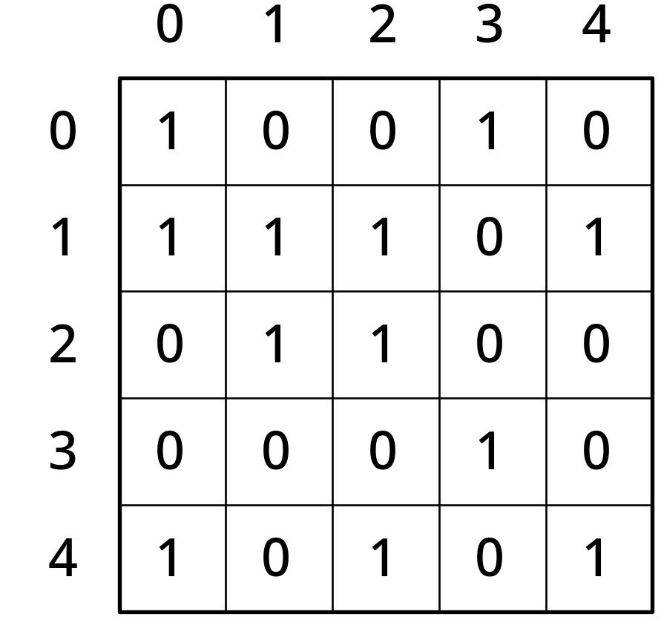
Figure 12-5: An Adjacency Matrix representation of Figure 12-3
26年 11月 8日
Copyright © 1997 Oxford University Press
All Rights Reserved

Slide 8
ADT 12-1
Characteristics
An Undirected Adjacency List Graph G = (V,E) stores an undirected graph so that vertex neighbors can be found efficiently.
The number of vertices in the graph, n = |V|, is fixed when the graph is created.
The vertices are labeled 0…n-1.
Operations:
26年 11月 8日
Copyright © 1997 Oxford University Press
All Rights Reserved

Slide 9
ADT 12-1
int vertexSize()
Precondition: None.
Postcondtion: None.
Returns: The number of vertices in the graph, |V|.
int edgeSize()
Precondition: None.
Postcondtion: None.
Returns: The number of edges in the graph, |E|.
26年 11月 8日
Copyright © 1997 Oxford University Press
All Rights Reserved

Slide 10


ADT 12-1
void addEdge(i,j)
Precondition:
Postcondition:
int nextNeighbor(i)
Precondition:
Postcondition: If the current iterator position is within the neighbor list, it’s advanced to the next neighbor; if it’s at the end of the neighbor list, it’s reset to the beginning.
Returns: The next neighbor of i, or n if at the end of the list.
26年 11月 8日
Copyright © 1997 Oxford University Press
All Rights Reserved

Slide 11
ADT 12-2
Characteristics
A Directed Adjacency List Graph G = (V,E) stores an directed graph so that vertex neighbors can be found efficiently. The number of vertices in the graph, n = |V|, is fixed when the graph is created. The vertices are labeled 0…n-1.
Operations:
26年 11月 8日
Copyright © 1997 Oxford University Press
All Rights Reserved

Slide 12
ADT 12-2
int vertexSize()
Precondition: None.
Postcondition: None.
Returns: The number of vertices in the graph, |V|.
int edgeSize()
Precondition: None.
Postcondition: None.
Returns: The number of edges in the graph, |E|.
26年 11月 8日
Copyright © 1997 Oxford University Press
All Rights Reserved

Slide 13

ADT 12-2
void addEdge(i,j)
Precondition:
Postcondition:
int nextNeighbor(i)
Precondition:
Postcondition: If the current iterator position is within the neighbor list, it’s advanced to the next neighbor; if it’s at the end of the neighbor list, it’s reset to the beginning.
Returns: The next neighbor of i, or n if at the end of the list.
26年 11月 8日
Copyright © 1997 Oxford University Press
All Rights Reserved

Slide 14
ADT 12-3
Characteristics
An Undirected Adjacency Matrix Graph G = (V,E) stores an undirected graph so that vertex connectivity can be queried efficiently. The number of vertices in the graph, n =|V|, is fixed when the graph is created. The vertices are labeled 0…n-1.
Operations:
26年 11月 8日
Copyright © 1997 Oxford University Press
All Rights Reserved

Slide 15
ADT 12-3
int vertexSize()
Precondition: None.
Postcondition: None.
Returns: The number of vertices in the graph, |V|
int edgeSize()
Precondition: None.
Postcondition: None.
Returns: The number of edges in the graph, |E|
26年 11月 8日
Copyright © 1997 Oxford University Press
All Rights Reserved

Slide 16



ADT 12-3
void addEdge(i,j)
Precondition:
Postcondition:
bool edgeConnected(i,j)
Precondition:
Postcondition: None.
Returns: True if and only if Note that by convention
26年 11月 8日
Copyright © 1997 Oxford University Press
All Rights Reserved

Slide 17
ADT 12-4
Characteristics
A Directed Adjacency Matrix Graph G = (V,E) stores an directed graph so that vertex connectivity can be queried efficiently. The number of vertices in the graph, n = |V|, is fixed when the graph is created. The vertices are labeled 0…n-1.
Operations:
26年 11月 8日
Copyright © 1997 Oxford University Press
All Rights Reserved

Slide 18
ADT 12-4
int vertexSize()
Precondition: None.
Postcondition: None.
Returns: The number of vertices in the graph, |V|.
int edgeSize()
Precondition: None.
Postcondition: None.
Returns: The number of edges in the graph, |E|.
26年 11月 8日
Copyright © 1997 Oxford University Press
All Rights Reserved

Slide 19


ADT 12-4
void addEdge(i,j)
Precondition:
Postcondition:
bool edgeConnected(i,j)
Precondition:
Postcondition: None.
Returns: True if and only if Note that by convention
26年 11月 8日
Copyright © 1997 Oxford University Press
All Rights Reserved

Slide 20
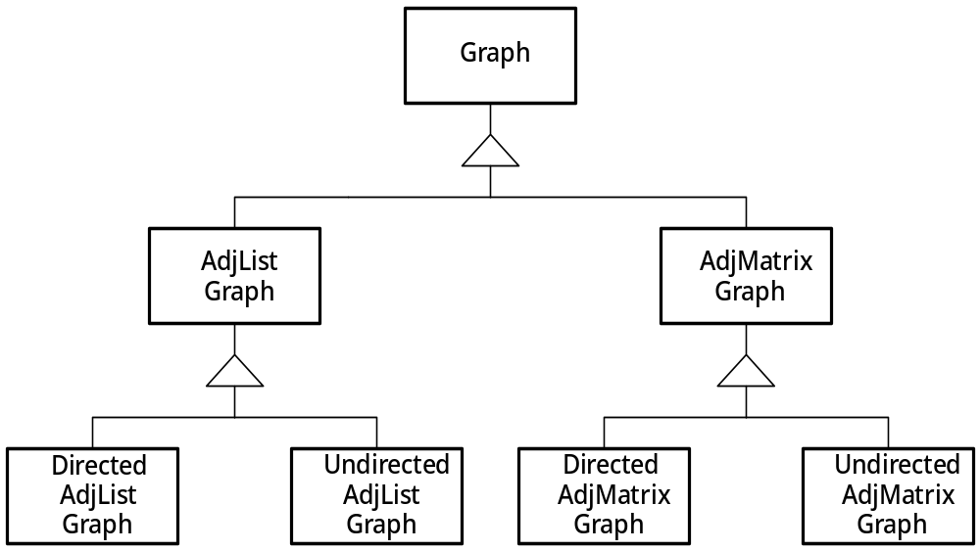
Figure 12-10: Inheritance Hierarchy for Graphs
26年 11月 8日
Copyright © 1997 Oxford University Press
All Rights Reserved

Slide 21
Code Example 12-1
// cx12-1.h
// Code Example 12-1: Header for graph hierarchy
#ifndef __MB_CX12_1__
#define __MB_CX12_1__
class graph {
public:
graph(int size) : n(size), m(0) { }
virtual int vertexSize() { return n; }
virtual int edgeSize() { return m; }
virtual void addEdge(int fromV, int toV) = 0; // specify abstract class
protected:
int n; // number of vertices
int m; // number of edges
};
#endif
26年 11月 8日
Copyright © 1997 Oxford University Press
All Rights Reserved

Slide 22
ADT 12-5: List ADT
Characteristics:
A List L stores items of some type, called ListElementType. The items in the List are ordered; the Lists (1,2) and (2,1) are distinct.
Operations:
void L.insert(ListElementType elem)
Precondition: None.
Postcondition: L = L with an instance of elem added to the end of L.
26年 11月 8日
Copyright © 1997 Oxford University Press
All Rights Reserved

Slide 23
ADT 12-5
bool L.first(ListElementType &elem)
Precondition: None.
Postcondition: If the list is empty, none. Otherwise, the variable elem contains the first item in L; the “next” item to be returned is the second in L.
Returns: true if and only if there is at least one element in L.
26年 11月 8日
Copyright © 1997 Oxford University Press
All Rights Reserved

Slide 24
ADT 12-5
bool L.next(ListElementType &elem)
Precondition: The “first” operation has been called at least once.
Postcondition: Variable elem contains the next item in L, if there is one, and the next counter advances by one; if there is no next element, none.
Returns: true if and only if there was a next item.
26年 11月 8日
Copyright © 1997 Oxford University Press
All Rights Reserved

Slide 25
Code Example 12-2
// cx12-2.h
// Code Example 12-2: Header, List class with List Iterator class
#ifndef __MB_CX12_2__
#define __MB_CX12_2__
#include "dslib.h"
template < class ListElementType >
class ListIter;
26年 11月 8日
Copyright © 1997 Oxford University Press
All Rights Reserved

Slide 26
Code Example 12-2
template < class ListElementType >
class List {
public:
List() : head(0) { }
virtual void insert(const ListElementType & elem);
friend class ListIter < ListElementType >;
protected:
struct Node;
typedef Node * Link;
struct Node {
ListElementType elem;
Link next;
};
26年 11月 8日
Copyright © 1997 Oxford University Press
All Rights Reserved

Slide 27
Code Example 12-2
Link head;
};
template < class ListElementType >
class ListIter {
public:
ListIter(const List < ListElementType > & l, ListElementType endFlag)
: myList(l), myEndFlag(endFlag), iterPtr(0) { }
virtual ListElementType operator++();
protected:
const List < ListElementType > & myList;
List < ListElementType >::Link iterPtr;
ListElementType myEndFlag;
};
#endif
26年 11月 8日
Copyright © 1997 Oxford University Press
All Rights Reserved

Slide 28
Code Example 12-3
// cx12-3.cpp
// Code Example 12-3: Implementation, List class with List Iterator class
#include "cx12-2.h"
template < class ListElementType >
ListElementType
ListIter < ListElementType > :: operator++()
{
if (iterPtr == 0)
iterPtr = myList.head;
else
iterPtr = iterPtr->next;
if (iterPtr)
return iterPtr->elem;
else
26年 11月 8日
Copyright © 1997 Oxford University Press
All Rights Reserved

Slide 29
Code Example 12-3
return myEndFlag;
}
template < class ListElementType >
void
List < ListElementType > :: insert(const ListElementType & elem)
{
Link addedNode = new Node;
assert(addedNode);
addedNode->elem = elem;
addedNode->next = head;
head = addedNode;
}
26年 11月 8日
Copyright © 1997 Oxford University Press
All Rights Reserved

Slide 30
Code Example 12-4
// cx12-4.h
// Code Example 12-4: Header for adjacency list base class
#ifndef __MB_CX12_4__
#define __MB_CX12_4__
#include "cx12-1.h" // graph base class
#include "cx12-2.h" // list class
typedef List < int > IntList;
typedef ListIter < int > IntListIter;
26年 11月 8日
Copyright © 1997 Oxford University Press
All Rights Reserved

Slide 31
Code Example 12-4
class ALGraph : public graph {
public:
ALGraph(int size) : graph(size)
{ vertexList = new IntList[n]; assert(vertexList); }
friend class NeighborIter;
protected:
IntList * vertexList;
};
class NeighborIter : public IntListIter {
public:
NeighborIter(const ALGraph & G, int startVertex) :
IntListIter (G.vertexList[startVertex], G.n)
{ assert(startVertex < G.n); }
};
#endif
26年 11月 8日
Copyright © 1997 Oxford University Press
All Rights Reserved

Slide 32
Code Example 12-5
// cx12-5.h
// Code Example 12-5: Header for Undirected Adjacency List Graphs
#ifndef __MB_CX12_5__
#define __MB_CX12_5__
#include "cx12-4.h"
class UALGraph : public ALGraph {
public:
UALGraph(int size) : ALGraph(size) { }
virtual void addEdge(int fromV, int toV);
};
#endif
26年 11月 8日
Copyright © 1997 Oxford University Press
All Rights Reserved

Slide 33
Code Example 12-6
// cx12-6.cpp
// Code Example 12-6: Implementation file for Undirected Adjacency List Graph
#include "cx12-5.h"
void
UALGraph::addEdge(int fromV, int toV)
{
assert(fromV < n && fromV >= 0 && toV < n && toV >= 0);
vertexList[fromV].insert(toV);
vertexList[toV].insert(fromV);
m++;
}
26年 11月 8日
Copyright © 1997 Oxford University Press
All Rights Reserved

Slide 34
Code Example 12-7
// cx12-7.h
// Code Example 12-7: Header for Directed Adjacency List Graph
#ifndef __MB_CX12_7__
#define __MB_CX12_7__
#include "cx12-4.h" // ALGraph -- Adjacency List Base Class
class DALGraph : public ALGraph {
public:
DALGraph(int size) : ALGraph(size) { }
virtual void addEdge(int fromV, int toV);
};
#endif
26年 11月 8日
Copyright © 1997 Oxford University Press
All Rights Reserved

Slide 35
Code Example 12-8
// cx12-8.cpp
// Code Example 12-8: Implementation file for Directed Adjacency List Graph
#include "cx12-7.h"
void
DALGraph::addEdge(int fromV, int toV)
{
assert(fromV < n && fromV >= 0 && toV < n && toV >= 0);
vertexList[fromV].insert(toV);
m++;
}
26年 11月 8日
Copyright © 1997 Oxford University Press
All Rights Reserved

Slide 36
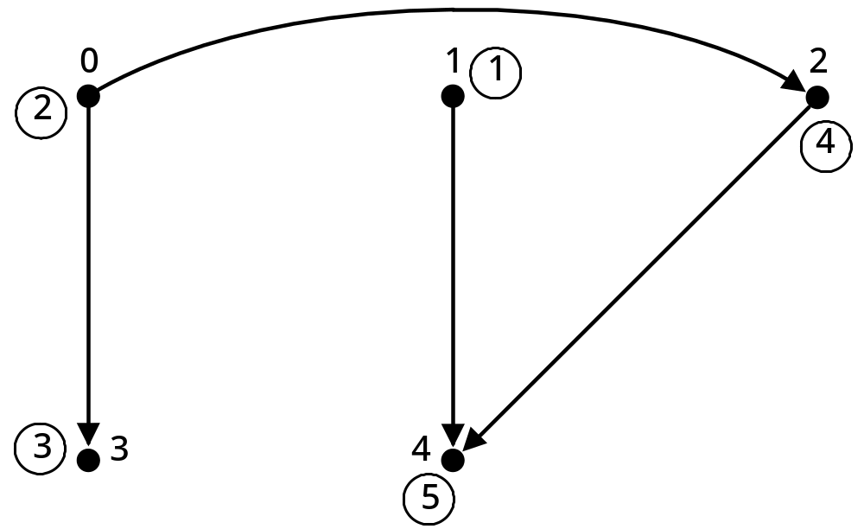
Partial order example
26年 11月 8日
Copyright © 1997 Oxford University Press
All Rights Reserved

Slide 37
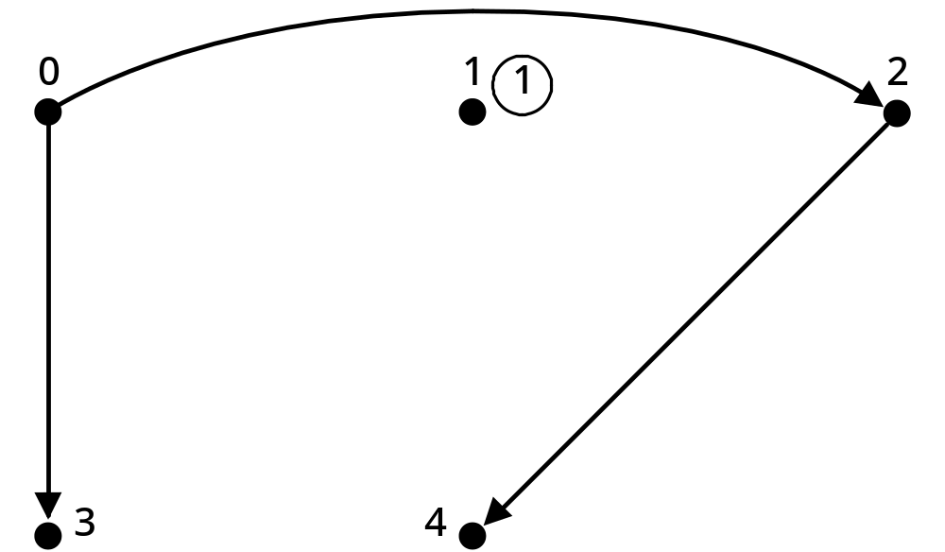
Figure 12-12: Topsort algorithm after one step
26年 11月 8日
Copyright © 1997 Oxford University Press
All Rights Reserved

Slide 38
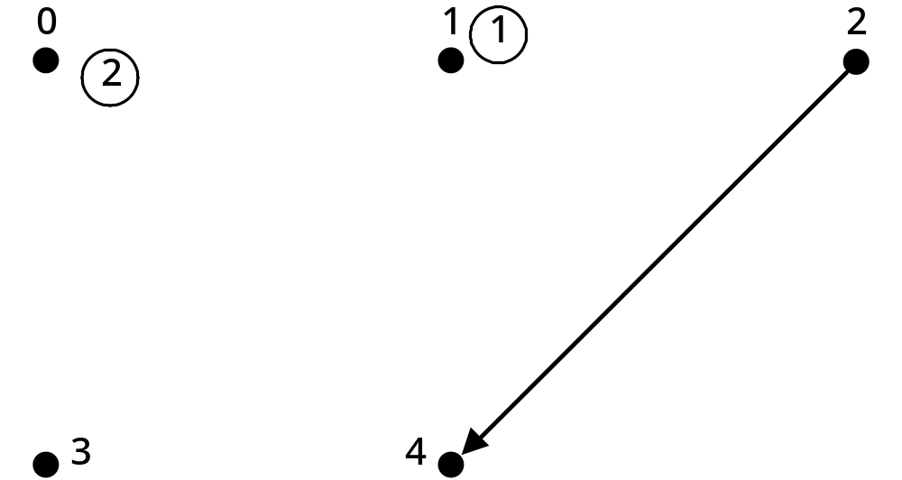
12-13: Topsort after the second step
26年 11月 8日
Copyright © 1997 Oxford University Press
All Rights Reserved

Slide 39
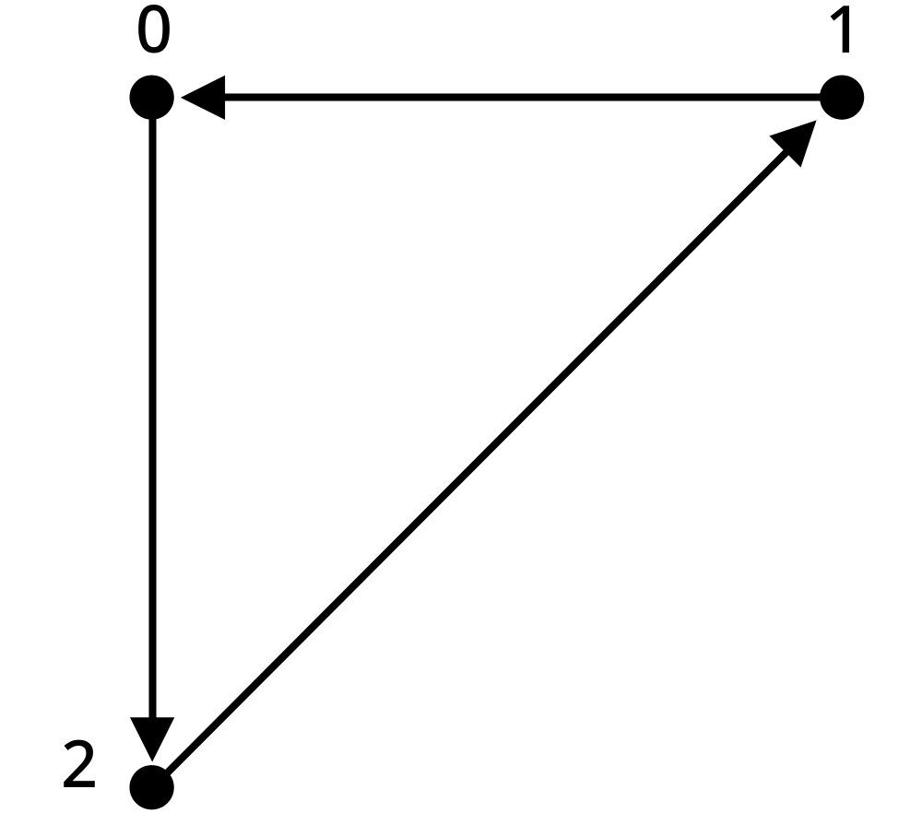
Figure 12-14: Graph with a cycle
26年 11月 8日
Copyright © 1997 Oxford University Press
All Rights Reserved

Slide 40
Algorithm 12-1:TOPSORT
nextLabel = 1
find all vertex with no in-edges and push them onto a stack
while the stack is not empty do
pop a vertex v from the stack
label(v) = nextLabel
add 1 to nextLabel
remove all other edges from v
if any neighbor of v now has no in-edge, push it onto the stack
if all vertices labeled,
report the labels
else
report that the digraph has a cycle
26年 11月 8日
Copyright © 1997 Oxford University Press
All Rights Reserved

Slide 41
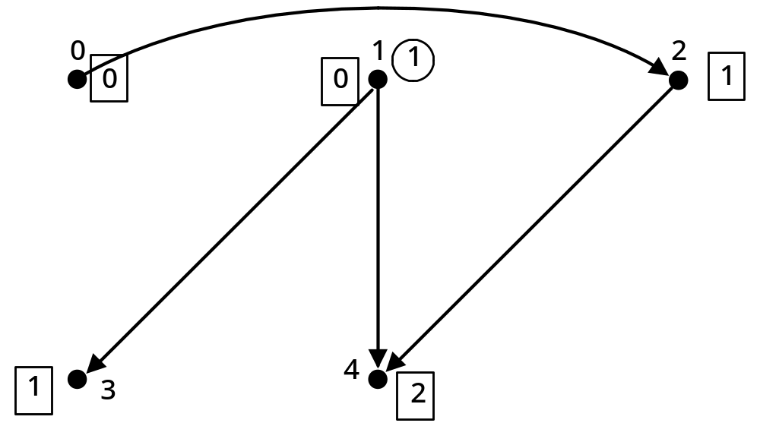
Figure 12-15: One Step in a Topological Sort
26年 11月 8日
Copyright © 1997 Oxford University Press
All Rights Reserved

Slide 42
Code Example 12-9
// cx12-9.cpp
// Code Example 12-9: Topological Sort
#include "dslib.h"
#include "cx12-7.h" // directed adjacency list graphs
#include "sx8-1.h" // stacks (supplemental version)
#include "cx9-4.h" // queues
#include <fstream.h>
int main()
{
// read graph from a file
// first entry is size of graph
const char * inFileName = "graph.dat";
ifstream ifs(inFileName);
assert(ifs); // make sure graph exists
26年 11月 8日
Copyright © 1997 Oxford University Press
All Rights Reserved

Slide 43
Code Example 12-9
int n;
ifs >> n;
DALGraph G(n);
cout << "Created graph; n = " << G.vertexSize() << endl;
// now read in the edges and add to the graph
int u, v;
while ( ifs >> u ) {
ifs >> v;
G.addEdge(u,v);
}
cout << "Edges in graph: m = " << G.edgeSize() << endl;
26年 11月 8日
Copyright © 1997 Oxford University Press
All Rights Reserved

Slide 44
Code Example 12-9
// count the number of in-edges for each vertex
int * vertices(new int[n]);
assert(vertices);
for (u = 0; u < n; u++)
vertices[u] = 0;
for (u = 0; u < n; u++) {
NeighborIter ni(G,u);
while ((v = ++ni) != n)
vertices[v]++;
}
26年 11月 8日
Copyright © 1997 Oxford University Press
All Rights Reserved

Slide 45
Code Example 12-9
// put vertices with no in-edge onto a stack
Stack < int > s;
for (u = 0; u < n; u++)
if (vertices[u] == 0)
s.push(u);
if (s.isEmpty()) {
cout << "graph has a cycle!\n";
return 0;
}
26年 11月 8日
Copyright © 1997 Oxford University Press
All Rights Reserved

Slide 46
Code Example 12-9
// begin topological sort
// As each vertex is identified, put it into a queue and
// decrement the number of in-edges for its neighbors
int count = 0; // number of vertices found so far
Queue < int > sortedEdges;
while (!s.isEmpty()) {
count++;
u = s.pop();
sortedEdges.enqueue(u);
// reduce in count for u's neighbors;
// for each that goes to zero, put on stack
NeighborIter ni(G,u);
26年 11月 8日
Copyright © 1997 Oxford University Press
All Rights Reserved

Slide 47
Code Example 12-9
while ((v = ++ni) != n) {
--vertices[v];
if (vertices[v] == 0)
s.push(v);
}
}
// check results
if (count < n)
cout << "Couldn't complete top sort -- cycle present.\n";
cout << "Ordering for top sort: \n";
while (!sortedEdges.isEmpty())
cout << sortedEdges.dequeue() << '\t';
cout << endl;
return n;
}
26年 11月 8日
Copyright © 1997 Oxford University Press
All Rights Reserved

Slide 48
실습예제
TopSort라는 프로젝트를 생성한다.
이전에 사용한 stack 과 queue template 파일들을 복사해서 프로젝트에 추가한다
graph.h 새항목추가에서 20쪽의내용 넣음
List.h 을 새항목추가해서 24-28쪽 내용을 추가
  List class 내용을 먼저 다 적고, 그다음에 ListIter class 내용을 적는다
  typename List < ListElementType >::Link iterPtr; 이렇게 수정
ALGraph.h 를 새항목추가해서 29-30쪽 내용을 추가한다. Include 파일은 은 graph.h, list.h 를 포함함.
DALGraph 클래스를 추가. 33-34 내용을 .h 와 .cpp 파일에 추가한다
Main 함수에 41-46쪽 내용을 복사한고 필요한 header 파일 추가한다
작업디렉토리에 graph.dat 파일을 만들고 내용은 35쪽 그림을 기준으로 만든다
26年 11月 8日
Copyright © 1997 Oxford University Press
All Rights Reserved

Slide 49
Code Example 12-10
// cx12-10.h
// Code Example 12-10: Header for adjacency matrix base class
#ifndef __MB_CX12_10__
#define __MB_CX12_10__
#include "dslib.h"
#include "cx12-1.h" // graph base class
class amGraph : public graph {
public:
amGraph(int size);
virtual bool edgeMember(int fromV, int toV);
protected:
int * * am; // am points to pointers to int
};
#endif
26年 11月 8日
Copyright © 1997 Oxford University Press
All Rights Reserved

Slide 50
Code Example 12-11
// cx12-11.cpp
// Code Example 12-11: Implementation for adjacency matrix base class
#include "cx12-10.h"
amGraph::amGraph(int size) : graph(size)
{
int i;
am = new int * [n]; // make an array of pointers to int
assert(am);
26年 11月 8日
Copyright © 1997 Oxford University Press
All Rights Reserved

Slide 51
Code Example 12-11
for (i = 0; i < n; i++) {
am[i] = new int[n]; // make an array of ints
assert(am[i]);
int j;
for (j = 0; j < n; j++) // initialize the array to 0
am[i][j] = 0;
}
}
bool amGraph::edgeMember(int fromV, int toV)
{
assert (fromV < n && toV < n && fromV >= 0 && toV >= 0);
return bool(am[fromV][toV] != 0);
}
26年 11月 8日
Copyright © 1997 Oxford University Press
All Rights Reserved

Slide 52
Code Example 12-12
// cx12-12.h
// Code Example 12-12: Header for directed adjacency matrix class
#ifndef __MB_CX12_12__
#define __MB_CX12_12__
#include "cx12-10.h" // adjacency matrix base class
class dAMGraph : public amGraph {
public:
dAMGraph(int size, int initialValue = 0) :
amGraph(size) { }
virtual void addEdge(int fromV, int toV);
};
#endif
26年 11月 8日
Copyright © 1997 Oxford University Press
All Rights Reserved

Slide 53
Code Example 12-13
// cx12-13.cpp
// Code Example 12-13: Implementation for directed adjacency matrix class
#include "cx12-12.h"
void dAMGraph::addEdge(int fromV, int toV)
{
assert(fromV < n && toV < n && fromV >= 0 && toV >= 0);
if (!edgeMember(fromV, toV)) {
m++;
am[fromV][toV] = 1;
}
}
26年 11月 8日
Copyright © 1997 Oxford University Press
All Rights Reserved

Slide 54
Code Example 12-14
// cx12-14.h
// Code Example 12-14: Header for undirected adjacency matrix class
#ifndef __MB_CX12_14__
#define __MB_CX12_14__
#include "cx12-10.h"
class uAMGraph : public amGraph {
public:
uAMGraph(int size, int initialValue = 0) :
amGraph(size) { }
virtual void addEdge (int fromV, int toV);
};
#endif
26年 11月 8日
Copyright © 1997 Oxford University Press
All Rights Reserved

Slide 55
Code Example 12-15
// cx12-15.cpp
// Code Example 12-15: Implementation for undirected adjacency matrix class
#include "cx12-14.h"
void uAMGraph::addEdge(int fromV, int toV)
{
assert(fromV < n && toV < n && fromV >= 0 && toV >= 0);
if (!edgeMember(fromV, toV)) {
m++;
am[fromV][toV] = 1;
am[toV][fromV] = 1;
}
}
26年 11月 8日
Copyright © 1997 Oxford University Press
All Rights Reserved

Slide 56
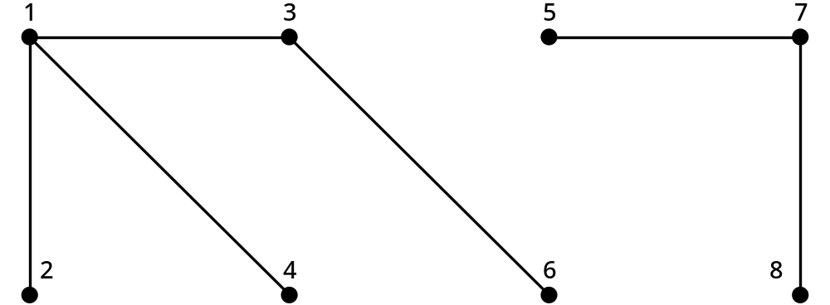
Figure 12-16: A Communications Network
26年 11月 8日
Copyright © 1997 Oxford University Press
All Rights Reserved

Slide 57


Definitions
12-1 A sequence [v₀,v₁,…,v_{k}] is a path from v₀ to v_{k} in an undirected graph G = (V,E) if and only if {v_{i}, v_{j+1}} E for all 1 i < k. The length of the path is k.
12-2 For a graph G = (V, E), the transitive closure graph G* = (V, E*) has edge {v₁,v₂} E* if and only if there's a path [v₁,…,v₂] in graph G.
26年 11月 8日
Copyright © 1997 Oxford University Press
All Rights Reserved

Slide 58
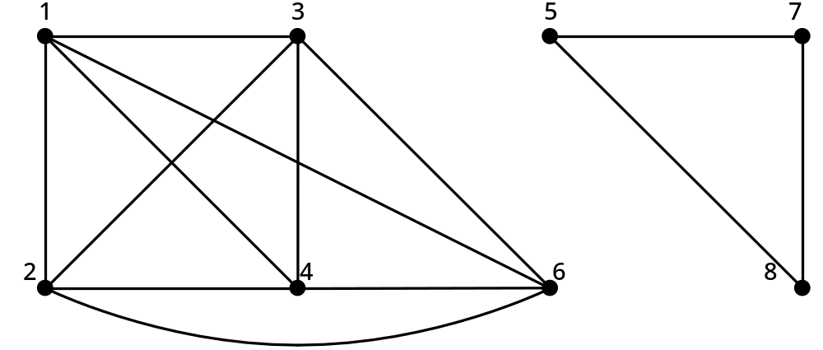
Figure 12-17: Transitive Closure of Graph from Figure 12-16
26年 11月 8日
Copyright © 1997 Oxford University Press
All Rights Reserved

Slide 59
Code Example 12-16
// cx12-16.cpp
// Code Example 12-16: Transitive Closure
#include "dslib.h"
#include "cx12-14.h"
#include <fstream.h>
int main()
{
const char * inFileName = "graph2.dat";
// read graph from a file
// first entry is size of graph
26年 11月 8日
Copyright © 1997 Oxford University Press
All Rights Reserved

Slide 60
Code Example 12-16
ifstream ifs(inFileName);
assert(ifs);
int n;
ifs >> n;
uAMGraph G(n);
cout << "Created graph; n = " << G.vertexSize() << endl;
int u, v;
while ( ifs >> u ) {
ifs >> v;
G.addEdge(u,v);
}
26年 11月 8日
Copyright © 1997 Oxford University Press
All Rights Reserved

Slide 61
Code Example 12-16
cout << "Edges in graph: m = " << G.edgeSize() << endl;
int step;
for (step=0; step < n; step++)
for (u = 0; u < n; u++)
for (v = 0; v < n; v++)
if (G.edgeMember(u,step) && G.edgeMember(step,v))
G.addEdge(u,v);
// print results
for (u=0; u < n; u++) {
cout << u << "\t: ";
for (v = 0; v < n; v++)
cout << (G.edgeMember(u,v)? "T " : "F ");
cout << endl;
}
return 0;
}
26年 11月 8日
Copyright © 1997 Oxford University Press
All Rights Reserved

Slide 62
실습예제
TransitiveClosure 라는 프로젝트를 만든다
TopSort 프로젝트의 graph.h 파일을 복사해서 현재 프로젝트에 추가
amGraph 클래스를 추가하고 내용은 48에서 50 을 복사
UAMGraph 클래스를 추가하고 내용은 53-54
Main 함수에 58-60 쪽 내용을 복사
  Main 함수에서 addEdge 할때 u-1, v-1로 수정
작업 디렉토리에 graph2.dat파일을 55쪽 그림에 맞게생성
26年 11月 8日
Copyright © 1997 Oxford University Press
All Rights Reserved

